Slide 2
Doing Business with DOE’s Office of Environmental Management (EM)
Aaron Deckard
Procurement Director
Environmental Management Consolidated Business Center
Ken Johnson
Small Business Program Manager
Office of Environmental Management
June 4, 2024

Slide 3
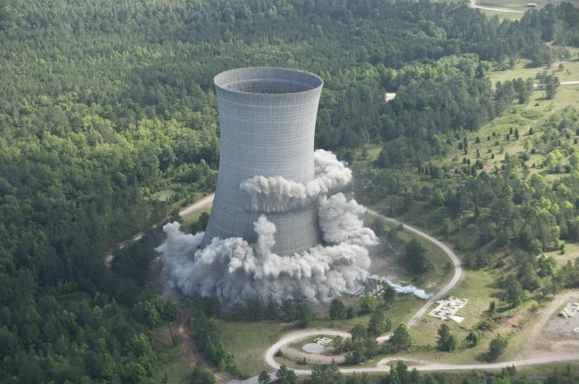
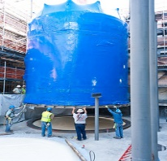
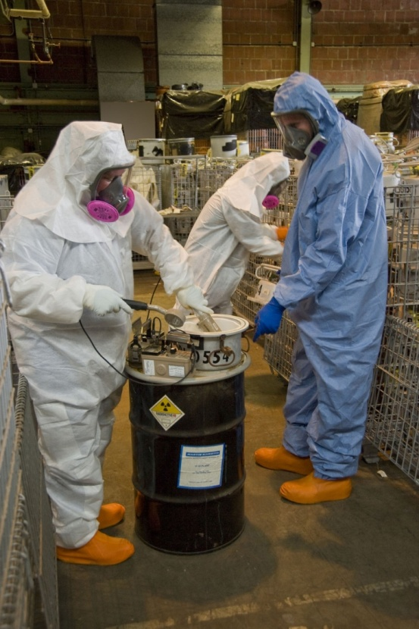
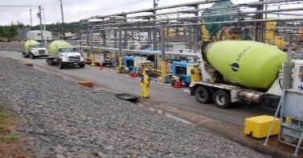
EM’s Commitment to Small Business First
EM has a long history of support to the DOE Small Business Program and a strong commitment to increasing small business awards to prime contractors and subcontractors to perform EM mission-critical work.
EM is committed to “Small Business First” (DOE Policy 547.1A), including the following key tenets:
Foster a dynamic business environment for the small business community
Promote inclusiveness in DOE-EM activities by advancing initiatives that attract the innovation and creativity of small businesses
Identify and remove barriers for small businesses wherever possible
Continue to champion partnerships, such as the DOE Mentor-Protégé Program

Slide 4
FY24 Small Business Goals for DOE Contracts
Category | Prime/with MOSRC* | Subcontracting (% of Prime Contractor $’s to Subcontracts)**
Small Business | 5%/17% | 49%
Small Disadvantaged Business | 8.15% | 8.15%
Woman-Owned Small Business | 5% | 5%
Service-Disabled Veteran-Owned Small Business | 5% | 5%
HUBZone | 3% | 3%
*Management & Operating Subcontract Reporting Capability data drawn from 1st-Tier small business subcontracts at participating DOE sites.
**Recent major EM prime contracts have also included subcontracting goals of 1% for non-ANC Indian tribes and 0.25% for Ability One.
DOE-EM PRIMARY NAICS CODES
NAICS Code | NAICS DESCRIPTION
541620 | ENVIRONMENTAL CONSULTING SERVICES
541611 | ADMINISTRATIVE MANAGEMENT AND GENERAL MANAGEMENT CONSULTING SERVICES
561210 | FACILITIES SUPPORT SERVICES
562211 | HAZARDOUS WASTE TREATMENT AND DISPOSAL
562910 | REMEDIATION SERVICES

Slide 5
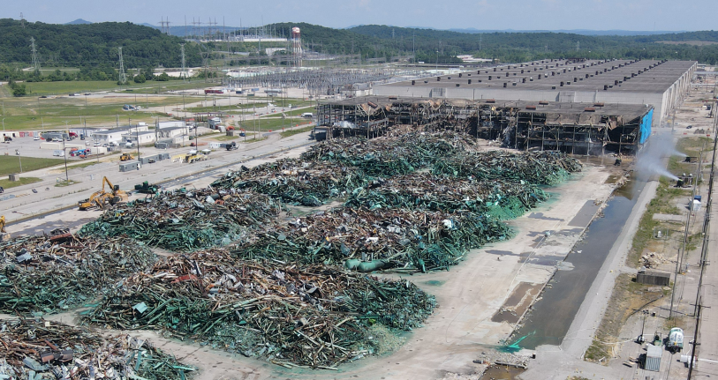
EM: A Vital and Important Mission
EM Mission: To complete the safe cleanup of the environmental legacy brought about from decades of nuclear weapons development and government-sponsored nuclear energy research.
EM's first priority is to ensure the safety and health of the public and EM's workforce while continuing to protect the environment.

Slide 6
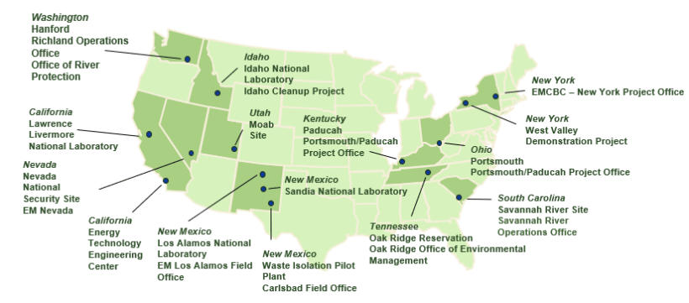
A Nationwide Effort

Slide 7
Six Primary Mission Areas
Special Nuclear Materials & Spent Nuclear Fuel
Radioactive Tank Waste
TRU & Solid Waste
Facility D&D
Site Services
Soil & Groundwater

Slide 8
Opportunities with EM
There are many ways to do business with EM, including but not limited to:
Prime Contracts
Large and small business primes for a wide range of services to include site cleanup/remediation contracts
IDIQs and BOAs (including the End State Contracting Model)
Strategic sourcing, including Supply Chain Management Center and Integrated Contractor Purchasing Team
Subcontracts
Teaming subcontractors
Post-award subcontracts (large and small business, including socio-economic)
Mentor-Protégé Program
GSA schedules
Use of set-aside and socio-economic programs

Slide 9
Increasing Small Business Participation
Direct prime contracts
Use of set-aside and/or socio-economic programs
Contracts to 8as, Indian country, and ANCs
Process generally begins with RFI (e.g., recent RFI for Bettis adjacent property development)
Subcontracting
Mandated goals in large business contracts
Hold contractors accountable for performance
Meaningful work
Mentor-Protégé program
SBA program and/or DOE program
Major RFPs/contracts require agreement(s)
Mentors provide technical assistance, business development, planning, strategy, guidance
Strategic Sourcing
Metrics contribute toward category management achievement
Supply Chain Management Center and Integrated Contractor Purchasing Team
Self-identify as potential supplier; small business credit
Notes:
Ken

Slide 10
Procurement Equity
OMB Memo M-22-03, Advancing Equity in Federal Procurement: https://www.whitehouse.gov/wp-content/uploads/2021/12/M-22-03.pdf
Increased focus on Small Disadvantaged Business (SDB) goals
Increase spending for other socioeconomic small businesses/traditionally underserved businesses
Increase small business supplier base, including expanded outreach and engagement
Preference to set-aside for small business (including socioeconomic set-asides) wherever possible
If not, include substantive subcontracting requirements, including socioeconomic categories

Slide 11
Small Business Inclusion
Small Business Clauses and Provisions in Major EM Contracts
Section H, Subcontracted Work
Section B, Small Business Subcontracting Fee Reduction Clause
Sections L/M, Small Business Participation
Teaming Subcontractors (Not subject to post-award subcontract consent)
Mentor-protégé agreements
Sections C/L/M, Improvements to work processes, procedures, and technologies throughout the contract/ordering period
EM is interested in input from industry regarding ideas for further gains in small business inclusion at the prime and subcontract level

Slide 12
Current Major Acquisitions
EM Sites
PPPO Operations and Site Mission Support (formerly DUF6)
PPPO Technical Support Services *
HQ/Corporate Initiatives
Elemental Mercury Long-Term Management and Storage
Paducah Infrastructure Support Services *
Oak Ridge Technical, Management, and Administrative *
West Valley Phase 1B (ESCM)
SB Nationwide DD&R * (including ETEC Task Order) (recent award)
EM HQ Consolidated Technical Support Services *
LB Nationwide DD&R Task Orders
Naval Reactors Cleanup
*Small Business Set-aside

Slide 13
Current Acquisitions – Small Business
Oak Ridge Technical, Management, and Administrative Services
Solicitation No. 89303324REM000126
EM HQ Consolidated Technical Support Services
Solicitation No. 89303322REM000114
Paducah Infrastructure Support Services
Solicitation No. 89303323NEM000040
EM HQ and EMCBC IT and Cyber
Solicitation No. TBD; RFI issued 5/23/24
Procurement Websites
https://www.emcbc.doe.gov/SEB

Slide 14
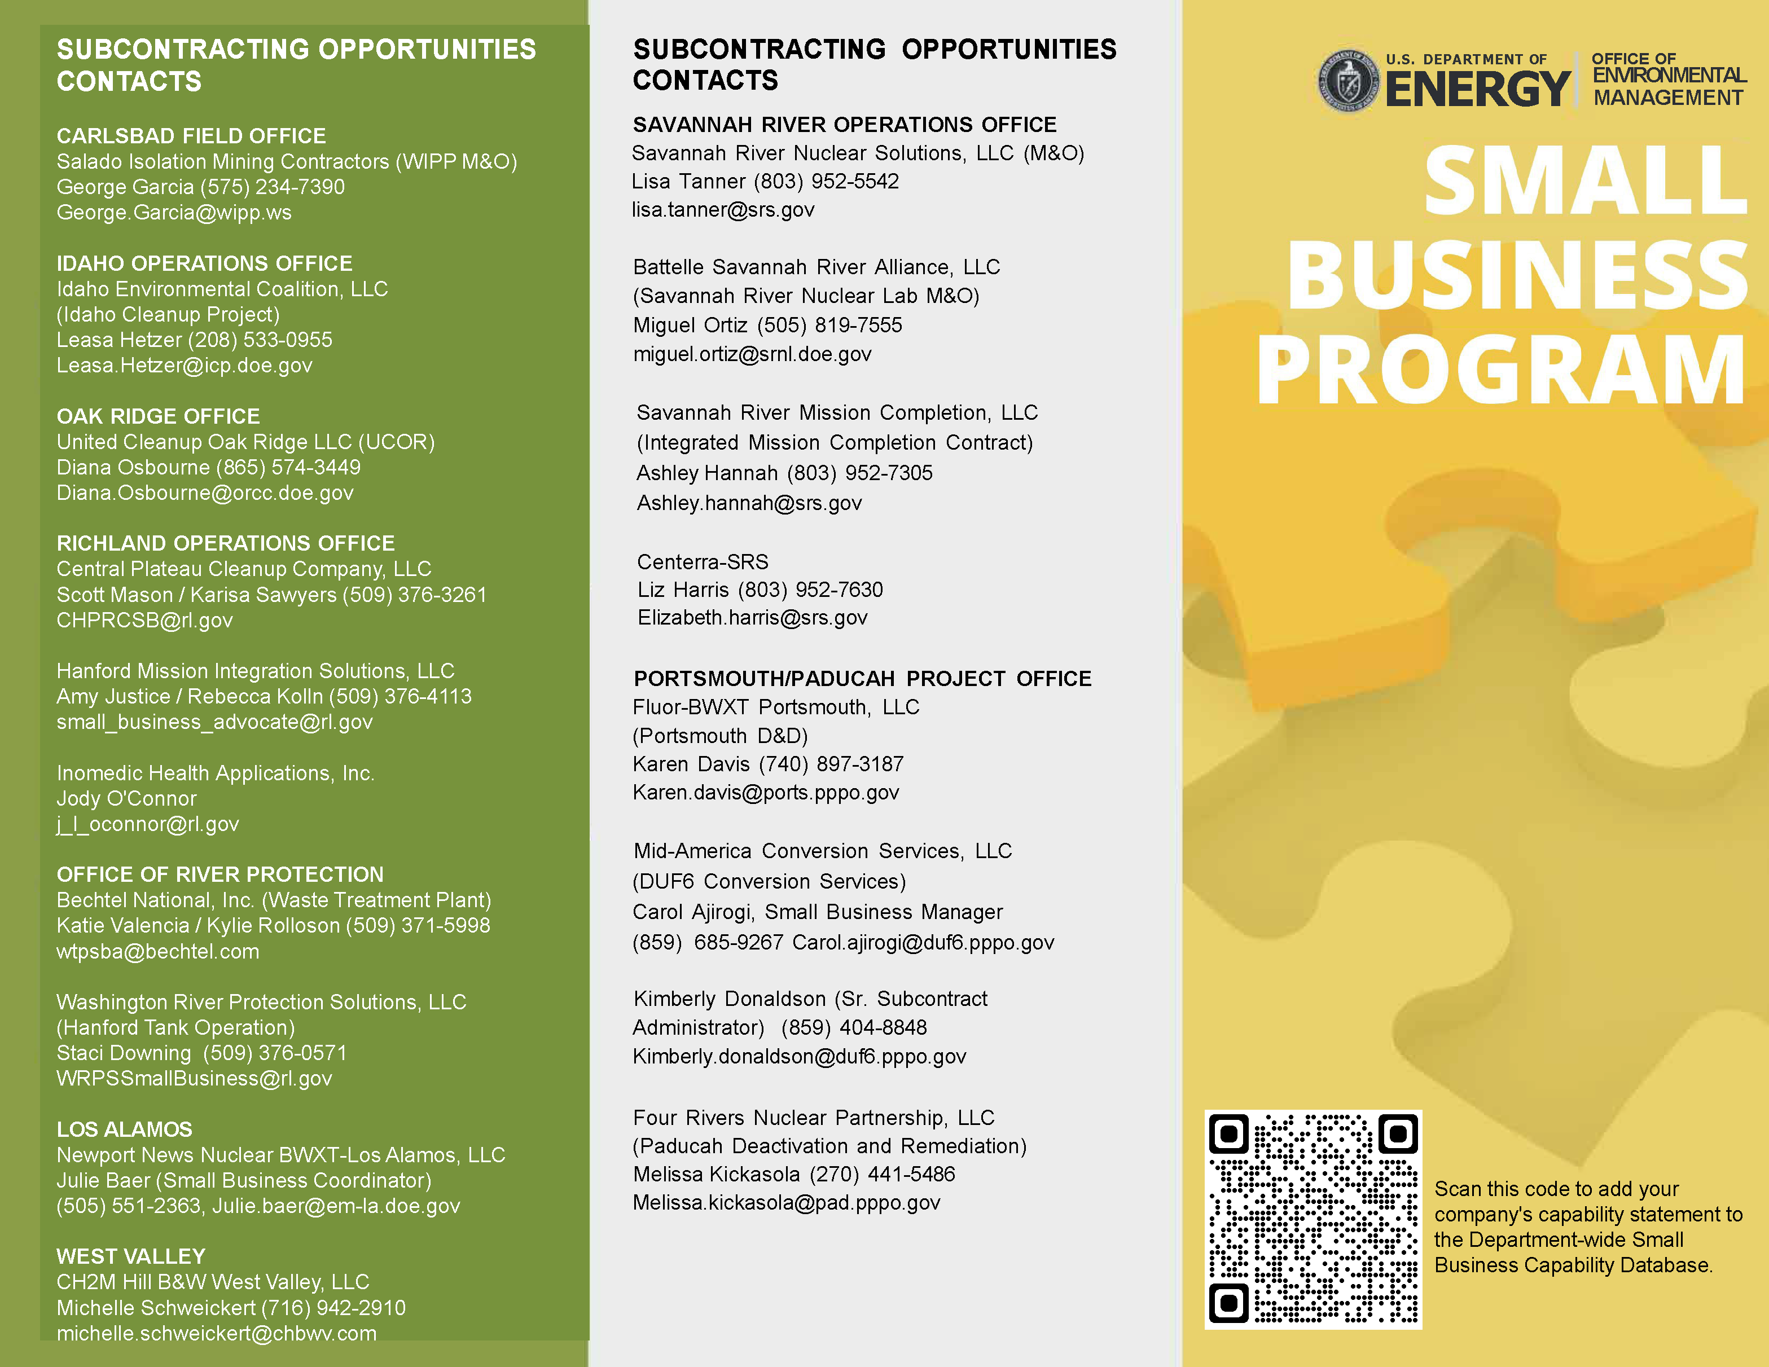
Working with EM Prime Contractors: Subcontracting POCs
EM Small Business Resources: https://www.emcbc.doe.gov/SEB/EM_QBO

Slide 15
Supply Chain Management Center (SCMC)
Key Features
DOE Goal of 4% Cost Savings annually through Strategic Sourcing.
NNSA holds a contract with the SCMC for strategic cost savings.
EM partners with NNSA to utilize the contract.
SCMC offers Cost Saving Agreements to EM Prime Contractors in the areas of Information Technology, Operating Supplies, and Professional Services.
Currently over 100 agreements, a majority of which are held by small businesses.
Agreements meet applicable requirements of DOE Policy Flash 2014-18, more commonly known as the “Golden Ticket”.
Greater availability of services through SCMC in recent years, which more closely aligns with EM mission.
Compliance with FITARA requirements for IT services.
Future business opportunities are posted on the SCMC website: thescmcgroup.energy.gov
Contractors complete a supplier profile to be considered for future opportunities.
SCMC uses the data to select suppliers to best serve EM Prime Contractors.

Slide 16
Engagement Opportunities
Conference Engagement
Reverse Industry Day
Second EM Reverse Industry Day targeted for October 2024 at ETEBA BOTC
EM is Listening – Any Other Suggestions?
Waste Management Symposium
First EM Reverse Industry Day held May 2023
ETEBA Opportunities Forums
8a Conference
Reservation Economic Summit
OSDBU Small Business Conference
3rd Annual Small Business Thursday w/ Panels and Matchmaking – October 2024
Exclusive Focus on Small Business
Notes:
Ken

Slide 17
4 Basic Tips for New Federal Contractors
1. Make sure you are registered on SAM.gov
And make sure your registration is updated!
2. Do you qualify for a socioeconomic designation? Seek certification if so.
SDB/8(a), WOSB, SDVOSB, HUBZone.
3. Reach out to those who can help you.
4. Use your free resources.
Detailed questions are best.
You do not have to pay for guidance on registering on SAM or getting small business/socioeconomic certifications.
Contact the SBA, local APEX Accelerators, and federal Small Business Program Managers before hiring a consultant if you need help.
Notes:
Ken

Slide 18
Helpful Websites
DOE Small Business First Policy: https://www.directives.doe.gov/directives-documents/500-series/0547.1-APolicy-a
DOE OSDBU: https://www.energy.gov/osdbu/office-small-and-disadvantaged-business-utilization
DOE Acquisition Forecast: https://www.energy.gov/osdbu/small-business-toolbox/acquisition-forecast
DOE Mentor-Protégé Program: https://www.energy.gov/osdbu/programs/mentor-prot-g-program
EMCBC Major Procurements Website: https://www.emcbc.doe.gov/About/CurrentAcquisitionWebsites
EMCBC Prime Contracts: https://www.emcbc.doe.gov/About/PrimeContracts
EM Public Website: https://www.energy.gov/em/office-environmental-management

Slide 19
Your Opinion Matters!
Please complete the session/speaker evaluation, found in the mobile app.
Thank you!

Slide 20
Questions & Assistance
Aaron Deckard, Procurement Director, DOE-EMCBC
aaron.deckard@emcbc.doe.gov
Karen Bahan, Deputy Procurement Director, DOE-EMCBC
karen.bahan@emcbc.doe.gov
Ken Johnson, Small Business Program Manager, DOE-EM / DOE-EMCBC
kenneth.johnson@emcbc.doe.gov
Visit us at Booth 716!

